Slide 1

Customer Purchase Prediction
ISHTA RACHEL MATHEW
INTMCA2019-24
ROLL. NO: 26
Guide:
Ms. Anit james

Slide 2
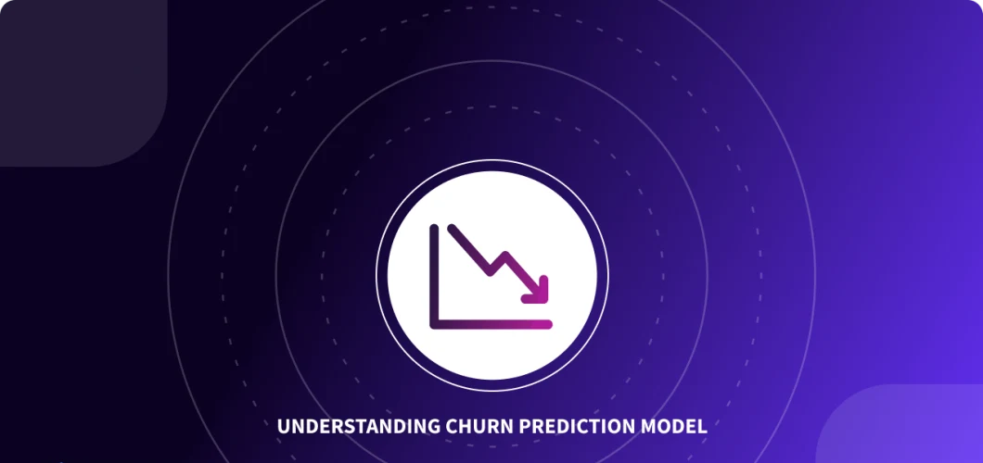
The Purchase Prognosticator: Forecasting Customer Buys

Slide 3
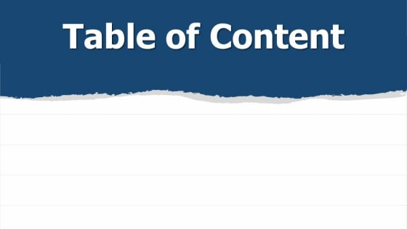
Abstract​
Literature Survey​
Introduction​
Methodology​
Results and Discussions​
Conclusion​
References ​

Slide 4

ABSTRACT
Predicting client purchase behavior has become a crucial task for e-commerce firms in today's data-driven business world.
This research presents a machine learning-based comprehensive client purchase prediction system.
To predict future purchase trends, this system uses the Random Forest and XGBoost algorithms to analyze previous consumer data, including financial indicators, frequency, and recency.
The model's accuracy is thoroughly assessed.

Slide 5


INTRODUCTION

Slide 6

Introduction
The code demonstrated in this session uses a variety of machine learning methods and instruments, including Random Forest, to generate a prediction system for customer purchases.
Through the examination of past consumer data, which includes variables like revenue, frequency, and recency, the system can anticipate future purchase behavior with high accuracy.
Businesses aiming to optimize profitability and customer happiness through customized marketing tactics, inventory management, and customer engagement will find this expertise to be of great use.

Slide 7

LITERATURE SURVEY
Amid the ever-evolving landscape of e-commerce, the significance of predicting customer purchase behavior has become increasingly evident.
This section presents an overview of seminal research in this domain, providing valuable insights into the evolution of predictive methodologies for enhancing user experience and business performance.

Slide 8
LITERATURE SURVEY
Paper [1] "Analyzing Customer Behavior in Online Retail: Challenges and Opportunities" by J. Smith et al. (2018) highlights the critical role of understanding customer behavior in the context of e-commerce platforms.
The study explores challenges and opportunities in leveraging data-driven insights to predict and influence purchasing patterns.
One of the key focal points of the paper is the recognition of the myriad challenges faced by e-commerce businesses when attempting to understand and predict customer behavior.

Slide 9
LITERATURE SURVEY
Paper [2] "Enhancing User Engagement through Personalized Recommendations in E-commerce" by L. Chen et al. (2020) explores the integration of personalized recommendation systems in e-commerce platforms.
It underlines the connection between user engagement and tailored purchase predictions and introduces collaborative filtering techniques for improved recommendation accuracy.
One of the key contributions of this paper is the emphasis on the strong connection between user engagement and the accuracy of personalized purchase predictions.

Slide 10
LITERATURE SURVEY
Paper [3] "Forecasting E-commerce Sales: A Comparative Analysis of Machine Learning Models" by M. Gonzalez (2018) presents a comparative analysis of machine learning models for forecasting e-commerce sales trends.
The study underscores the need for accurate predictions to optimize inventory management and customer satisfaction.
The research highlights the potential of machine learning in providing accurate and timely sales predictions.

Slide 11

Methodology
The methodology of our Customer Purchase Prediction System involves a multifaceted approach.
Initially, we preprocess and explore the dataset, handling missing values and transforming features.
Next, we create customer segments based on recency, frequency, and monetary value using clustering techniques.
These segments help us understand customer behavior. Subsequently, we employ various machine learning models to predict customer purchase behavior.
Techniques such as Random Forest, XGBoost, and others are used and evaluated to identify the most accurate predictor.​

Slide 12
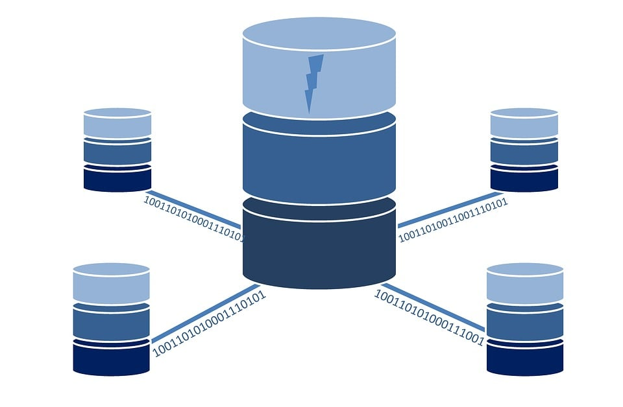
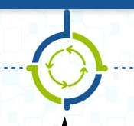

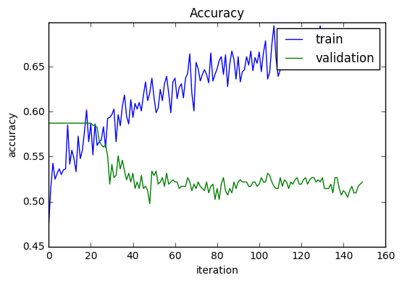
Tasks Including:
Data Collection
Data Preprocessing
Machine Learning Model Selection
Training and Evaluation

Slide 13
Data Collection
Data Preprocessing
Interactions on the e-commerce website streamline data collecting for our Customer Purchase Prediction System.
Preferences, purchase history, and behavioral information about users are automatically gathered and arranged for examination.
​
The gathered data is carefully preprocessed. This includes encoding categorical variables, addressing missing values, and normalizing data.
Making ensuring the data is organized and clean for machine learning is the aim.
​

Slide 14
Model Selection
Model Selection
Training and Evaluation
​A machine learning model that was carefully chosen depending on the prediction job is at the core of our system.
Models with classification capabilities such as Random Forest and XGBoost are taken into consideration for customer purchase prediction
Using historical data, the Random Forest and XGBoost models are trained based on Recency-Frequency-Monetary Metrics (RFM).
Their performance is extensively evaluated, and a classification report is provided that includes metrics for precision, recall, and F1-score in addition to accuracy.

Slide 15
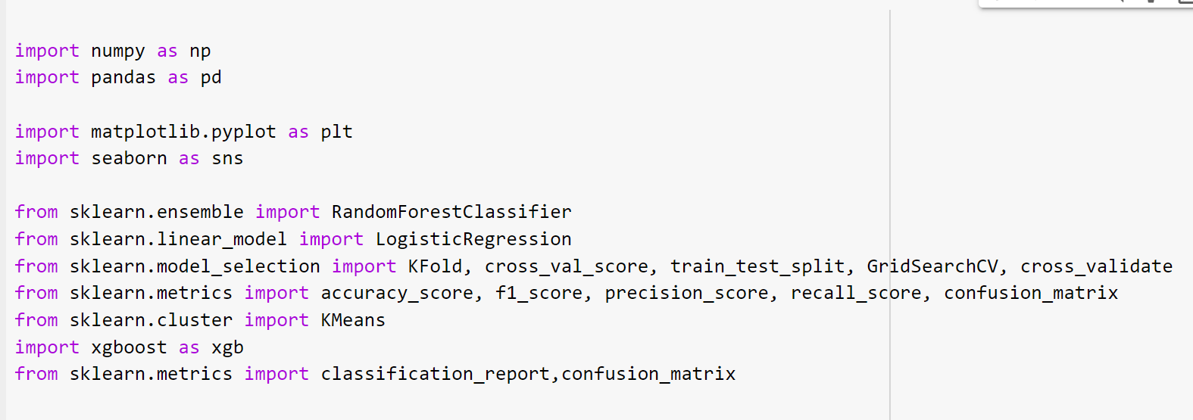
Build Model
The model building is the main step in the purchase prediction. While building the model, user use the algorithms. The steps involved are:
Import Libraries

Slide 16
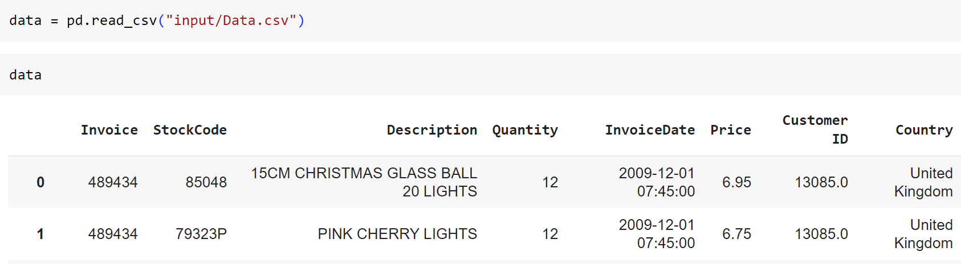
Build Model
Load Dataset

Slide 17
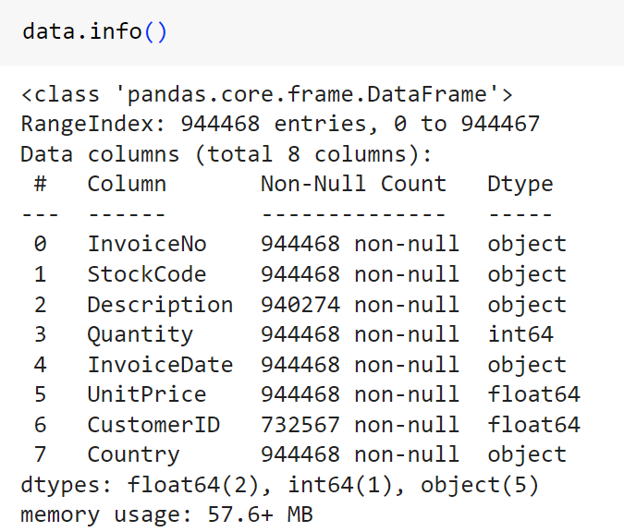
Build Model
Data Cleaning and Handling Missing Values

Slide 18
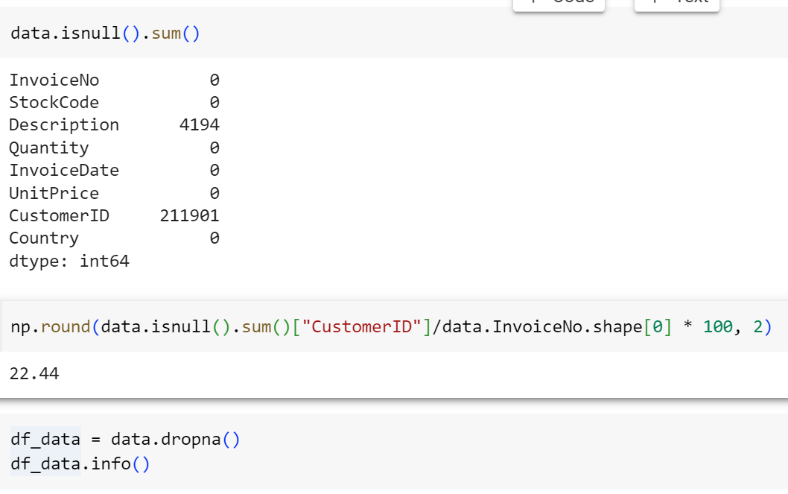
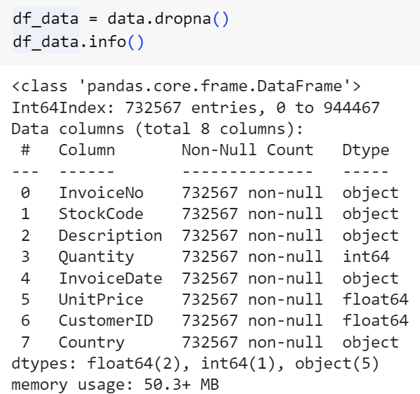
Build Model
Data Cleaning and Handling Missing Values

Slide 19
Build Model
Feature Engineering
Feature engineering is a crucial step in the machine learning pipeline where you create new features or modify existing ones to improve the performance of your model.
In this code, feature engineering is performed to prepare the data for classification modeling. Let's break down the key feature engineering steps in this code:

Slide 20
Build Model
Feature Engineering
Customer Segmentation:
The dataset is initially explored to understand customer behaviour. Segmentation is performed based on Recency, Frequency, and Monetary (Revenue) values.
Recency: The number of days since the last purchase by each customer.
Frequency: The count of purchases made by each customer.
Revenue: The total revenue generated by each customer.

Slide 21
Build Model
Customer Segmentation (RFM ANALYSIS)
K-Means Clustering for Recency:
K-Means clustering is applied to group customers based on their recency values (how recently they made a purchase).
The code calculates the optimal number of clusters and assigns each customer to a Recency cluster.
This clustering helps categorize customers into different groups based on their recency.

Slide 22
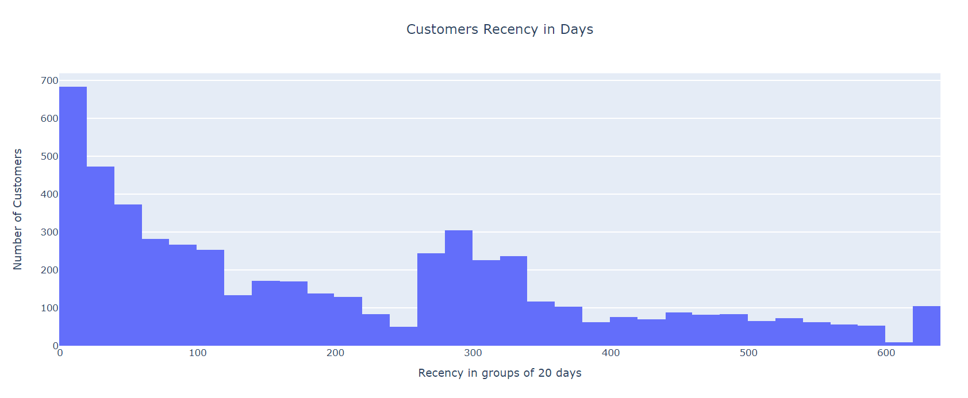
Build Model
Customer Segmentation (RFM ANALYSIS)

Slide 23
Build Model
Customer Segmentation (RFM ANALYSIS)
K-Means Clustering for Frequency:
Similar to recency, K-Means clustering is applied to group customers based on their purchase frequency.
The code calculates the optimal number of clusters and assigns each customer to a Frequency cluster.
This clustering helps categorize customers into different groups based on how frequently they make purchases.

Slide 24
Build Model
Customer Segmentation (RFM ANALYSIS)
K-Means Clustering for Revenue:
K-Means clustering is applied to group customers based on their total revenue generated.
The code calculates the optimal number of clusters and assigns each customer to a Revenue cluster.
This clustering helps categorize customers into different groups based on their monetary contribution.

Slide 25
Build Model
Customer Segmentation (RFM ANALYSIS)
Customer Segmentation:
Customers are categorized into different segments (Low-Value, Mid-Value, High-Value) based on their overall scores.
The segment indicates the type of customers they belong to, with high-value customers being the most valuable.
One-Hot Encoding:
The dataset is transformed using one-hot encoding to convert categorical features (such as the "Segment" feature) into a numerical format suitable for machine learning models.

Slide 26
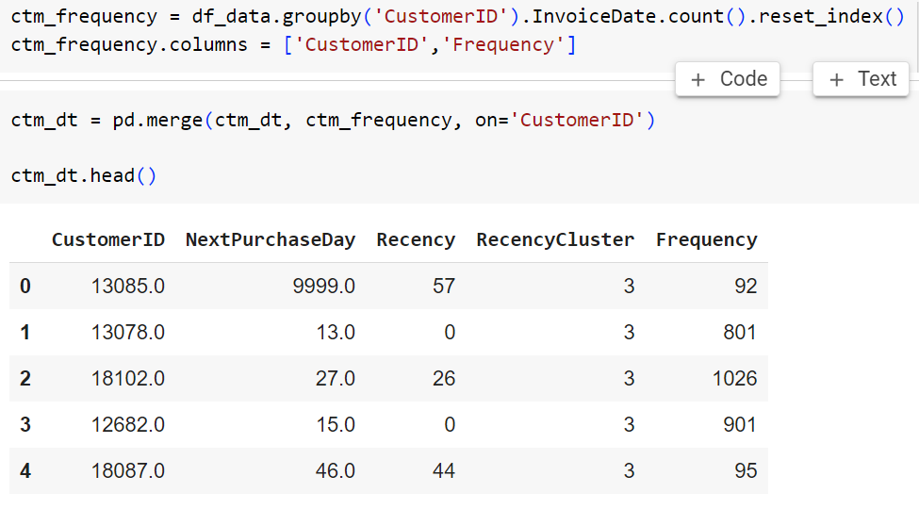
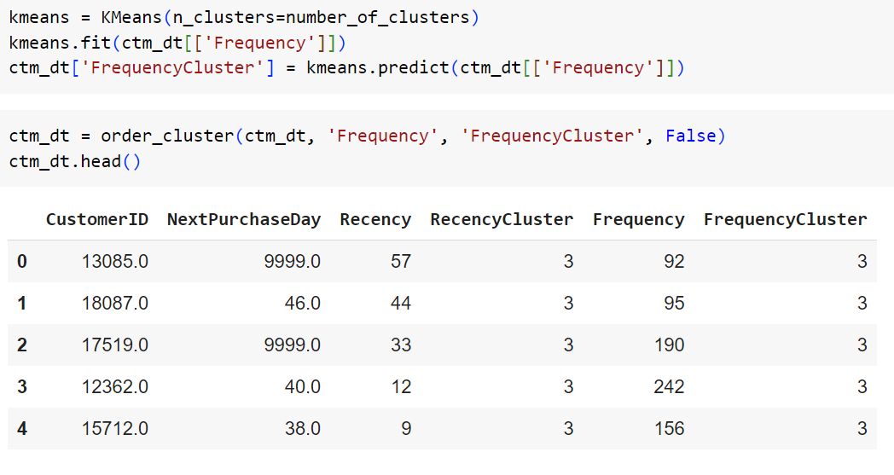
Build Model
Customer Segmentation (RFM ANALYSIS)

Slide 27
Build Model
Customer Segmentation (RFM ANALYSIS)
Next Purchase Day Range:
A new feature, "NextPurchaseDayRange," is created to indicate whether a customer is likely to make a purchase within the next 3 months (1) or after 3 months (0).
Correlation Analysis:
The code performs a correlation analysis to check the correlations between the features in the dataset.
Data Splitting:
The dataset is split into training and testing sets, which will be used for machine learning model training and evaluation.

Slide 28
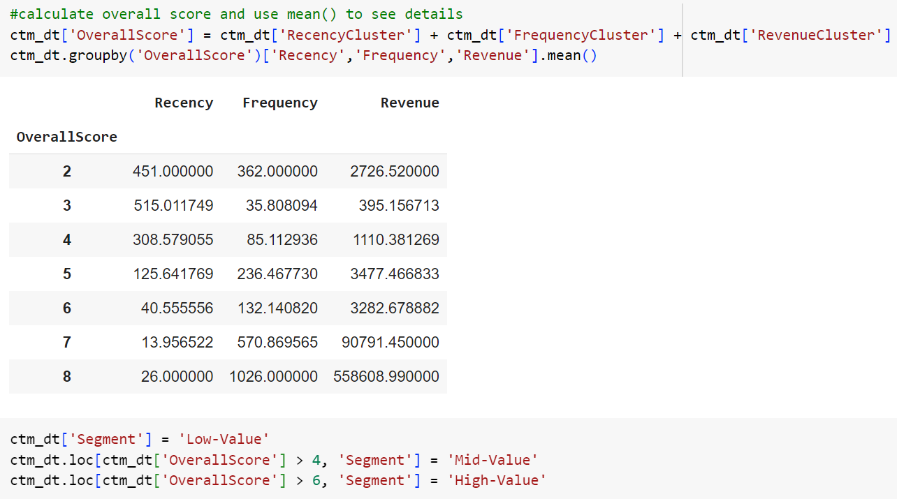
Build Model
Customer Segmentation (RFM ANALYSIS)

Slide 29
Results
Testing and Training:
Using historical data, the Random Forest and XGBoost
models are trained based on Recency-Frequency-Monetary
Metrics (RFM) to predict customer purchase behavior during
the Model Training and Evaluation phase. Their performance
is extensively evaluated, and a classification report is
provided that includes metrics for precision, recall, and F1-
score in addition to accuracy.

Slide 30
Results
Final Prediction
Both the Random Forest and the improved XGBoost models are used to forecast client purchase in the last predictions step. The dataset is then smoothly updated with these predictions. This methodology facilitates an all encompassing examination of consumer conduct and serves as the cornerstone for customized corporate tactics.

Slide 31
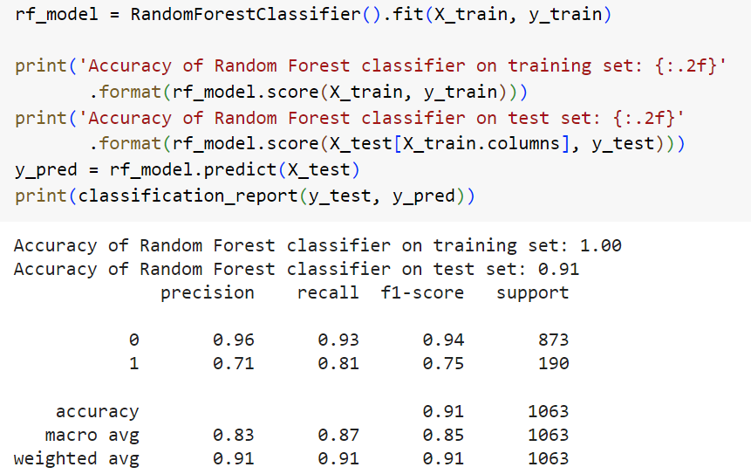
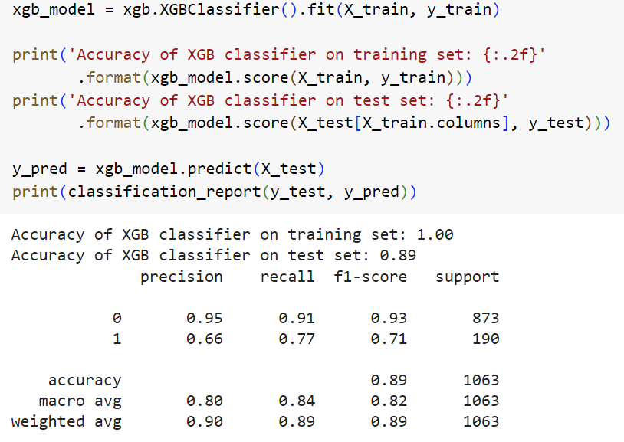
Results

Slide 32
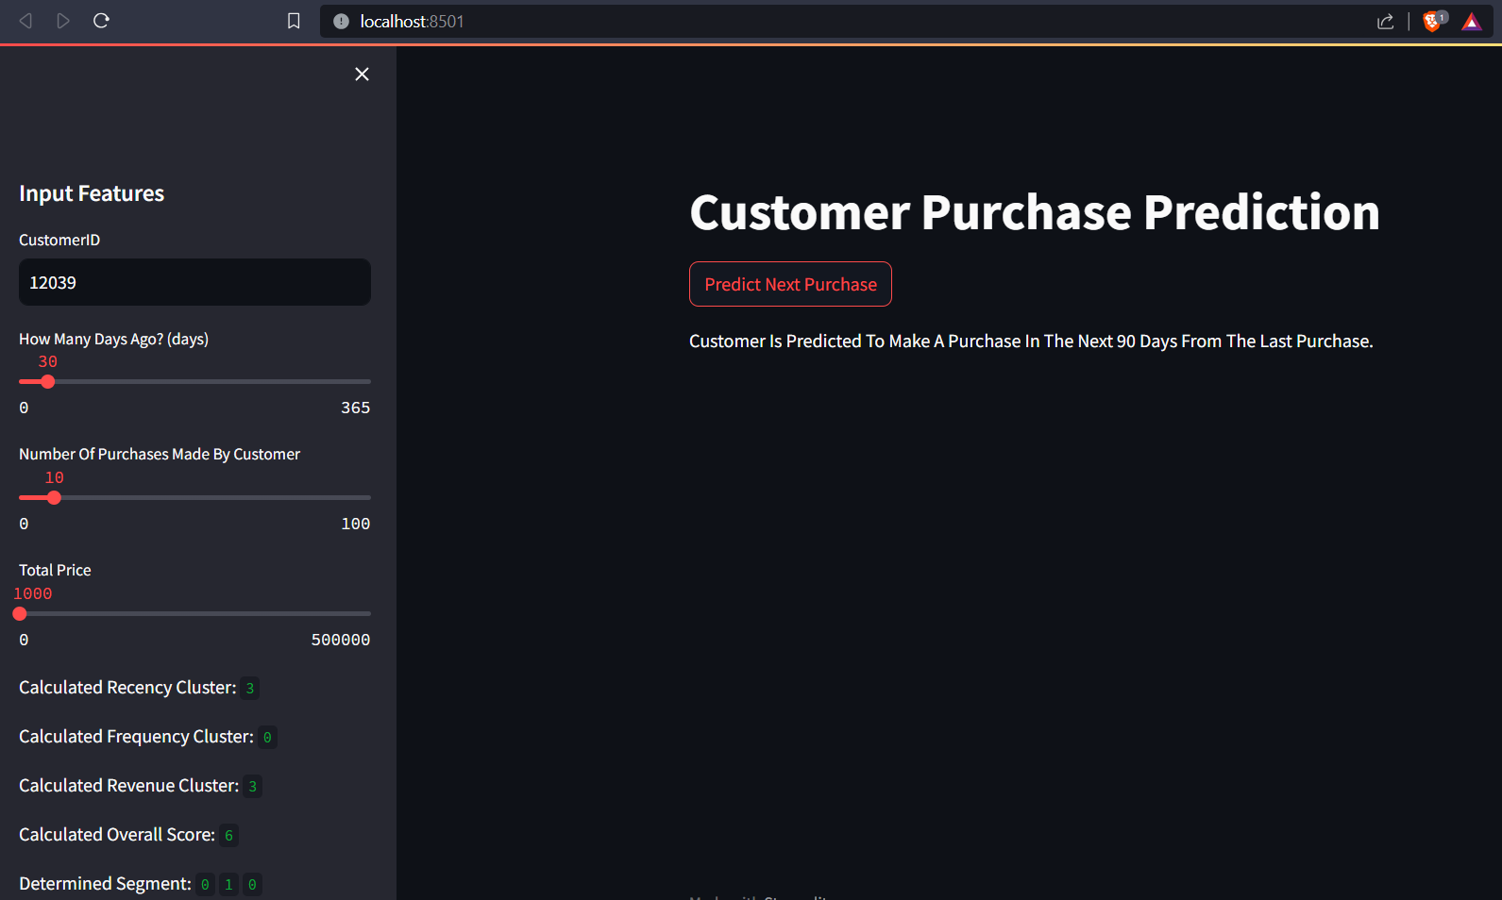
Results
Implementation

Slide 33
Conclusion
Predicting when customers are likely to make their next purchase on an online retail platform is the main objective of this research.
Profits are increased and business strategies are optimized thanks to this prediction.
Machine learning models such as Random Forest, XGBoost, and Logistic Regression are used to evaluate client behavior and forecast purchases.

Slide 34
References
[1] "Analyzing Customer Behavior in Online Retail: Challenges and Opportunities" by J. Smith et al. (2018)
[2] "Enhancing User Engagement through Personalized Recommendations in E-commerce" by L. Chen et al. (2020)
[3] "Forecasting E-commerce Sales: A Comparative Analysis of Machine Learning Models" by M. Gonzalez (2018)
[4] "Dynamic Pricing Strategies and Upsell Opportunities in E-commerce" by S. Rao (2017)
[5] "Buyer Prediction Through Machine Learning" by Rashed Ibrahim Karmostaje

Slide 35


Thank you

